Slide 1
Analysis of A/B Test Results
Data Scientist: Greg Hein
© 2024 Udacity.

Slide 2
Agenda
Findings of A/B test analysis
Experiment Setup
Conversion Rates
Experiment Results

Slide 3
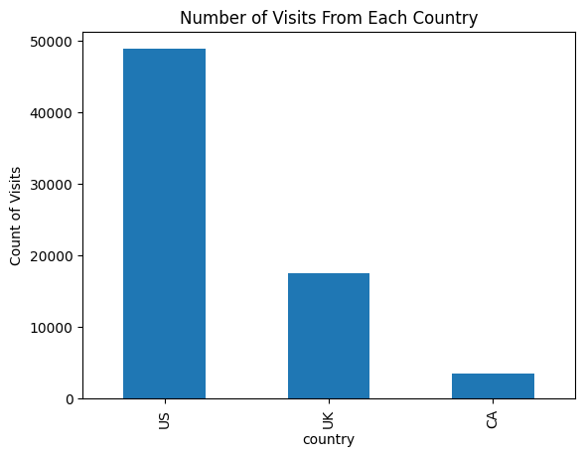
How Was the Experiment Implemented?
Total Variant Visitors: 69889
Total Control Participants: 34678

Slide 4
Conversion Rates
 | U.S. | U.K. | CA
Control | 10.7% | 10.2% | 9.4%
Treatment | 15.8% | 14.9% | 15.4%
Executive Summary: All three countries had similar conversion rates for both control and treatment. This suggests that the country of the visitors had little influence on conversion rate. In all three countries the treatment conversion rate was higher than the control conversion rate. This suggests the treatment may be having a positive effect.

Slide 5
Experiment Results
Treatment Conversion Rate: 0.1553
Control Conversion Rate:​ 0.1053
Delta in Treatment vs. Control Conversion Rate:​ 0.05
P-value:​ 0.0
Conclusion:
  The treatment conversion rate was larger than the control conversion rate. The p-value of 0.0 is below the Type I error rate (alpha) of 0.05, so the Null Hypothesis can be rejected. This is solid evidence to suggest that the treatment page results in a higher conversion rate than the control page.

